Slide 1
Enhanced Debugging Capabilities through the Application of Virtualization Technology
Master’s Thesis Defense
Ryan Wilson
Dr. Fawcett
December 2011

Slide 2
Research Statement
Combine virtualization technology with kernel debugging techniques to provide a more powerful set of debugging capabilities than those currently available
Enhance a debugger to provide a more robust set of features to distinguish and breakpoint on critical points in low-level code execution
With these enhancements, powerful improvements can be added to the current state-of-the-art in debugging technology

Slide 3
Development
Independent Study
Intel VT based Virtual Machine Monitor (VMM)
Leveraged a thin VMM written by Shawn Embleton in 2007
Found on www.rootkit.com (no longer available)
Used this example and the Intel specifications to learn to write a VMM
Intel x86 Kernel Debugger back-end
Followed the Intel specifications
The aforementioned VMM and Kernel debugger were further extended to perform the experiments in this thesis

Slide 4
Motivations
Personal Experience and Interests
Embedded and boot-environment development
Development and debugging of code outside of a standard operating system
Operating System device drivers
Development, debugging, and analysis of low-level device drivers
Software reverse engineering
Dynamic analysis of executable code with no available source or symbols
Malware analysis

Slide 5
Motivations
Motivating Problems
Analysis of executables with no available source code or symbols can become especially time consuming
Memory and port I/O breakpoints provide limited search and analysis capabilities
A limit of four hardware breakpoints can increase the difficulty of complex dynamic analysis
Debugging error states often crashes the debugger along with the target code since they run in the same context

Slide 6
Motivation
Motivating Problems
Many existing debuggers are specific to an Operating System and also may not be compatible with certain hardware configurations
SoftICE – No longer supported (Windows 2000), video card issues
Syser Debugger – Windows only, does not support USB keyboard and mouse
WinDbg – Windows only, dual machine required for full capabilities
Debugging code outside of a popular operating system, or before it is fully loaded, is a challenge
i.e. Boot-loader code
Available solutions could cost over $10,000, such as an Arium JTAG debugger

Slide 7
Debugger Background
Hardware Breakpoint
Configured through the processor’s internal debug registers
Configured to trap on either a port I/O or virtual memory address
Memory read/write and instruction execution
Breakpoint range set to 1, 2, 4, or 8 byte length
Up to four simultaneous hardware breakpoints
Traps to interrupt handler 0x01 when triggered

Slide 8
Debugger Background
Software Breakpoint
Added to software by replacing the first byte of an instruction with 0xCC
The breakpoint handler restores the instruction after the breakpoint is triggered
Can only be configured to trap on a memory address
A nearly unlimited number of software breakpoints can be placed
Traps to interrupt handler 0x03 when triggered

Slide 9
Limitations of Native Debugging
Can only set breakpoints on memory and memory and port I/O addresses
Same privilege level as kernel code being debugged
Limited to four hardware breakpoints
Software breakpoints modify target code
Software breakpoints can only be set on memory addresses
Cannot distinguish between the type of memory access – i.e. read/write access vs. instruction execution

Slide 10
Intel VT-x VMM Background
Exit Conditions
An Intel VT-x VMM can be configured to halt guest software when a specified condition is met
These conditions are called VM exits, and allow for the VMM to maintain control over the guest
VM exits typically allow for the VMM to control low-level functionality associated with a system
A list of 55 VM exit condition categories are currently supported by Intel
Some of these include the CPUID command, MSR access, CR access, VMX instructions, the occurrence of a triple fault, I/O instructions, and exceptions

Slide 11
Summary of Accomplishments
Enhanced Debugging Capabilities
Enhance traditional debugging capabilities by creating “Virtual Breakpoints” through the use of Intel Virtualization Technology
Analogy between a debug breakpoint and a VM-Exit
Virtual breakpoint enhancements include:
More specific control over conditions that cause a breakpoint
Can set numerous virtual breakpoints
A VMM provides full control over a guest OS and its system state
Virtual breakpoints do not modify the guest software or operating system
Tailored virtual breakpoint can greatly reduce dynamic analysis time
Complex debug environments can be analyzed using virtual breakpoints

Slide 12
Additional Capabilities with Virtual Debugging
Can set breakpoints on any instruction or condition that causes a vm-exit
Higher level of control than the kernel or application code being debugged
Nearly unlimited number of breakpoints
Breakpoints do not modify target code or system state (not even debug registers)
Little to no impact on guest, except for timing

Slide 13
Technology Overview
Combination of standard Intel x86-based debugger capabilities and Intel VT-x hardware assisted virtualization technology
Intel x86 debugger capabilities
Debug Registers and software breakpoint opcode
Intel VT-x hardware assisted virtualization technology
Intel VMX instruction set
Purpose:
Enhanced Debugging Capabilities

Slide 14
Enhanced Debugging Capabilities
Analogy Between a Breakpoint and a VM Exit
Processor Executing Code in Memory
Breakpoint Condition Encountered
Interrupt Handler 0x01 or 0x03
Return to Standard Code Execution
Processor Executing Code in Guest OS
VM-Exit condition reached – Save Guest State
Execute VMM Software Handler
Restore Guest State - Return to Guest OS
Standard Breakpoint
Monitors memory or port I/O address
Processor execution is redirected to a software interrupt handler
VM-Exit Condition
Monitors a multitude of system level conditions / events
Guest OS is paused and processor execution is redirected to a software handler in the VMM

Slide 15
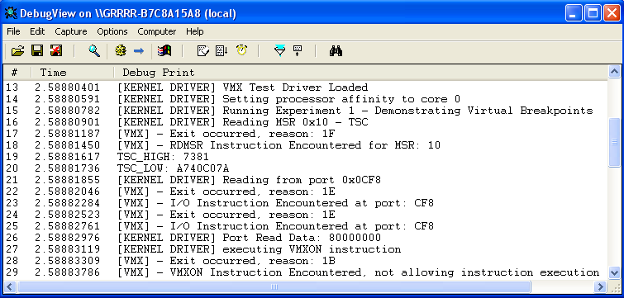
Enhanced Debugging Capabilities
Virtual Breakpoints
VM-Exits are used as “virtual breakpoints”
This experiment set and triggered virtual breakpoints on:
MSR Access, Port I/O access, VMX Instruction access
Breakpoints are set in the VMM and triggered from the Guest OS kernel

Slide 16
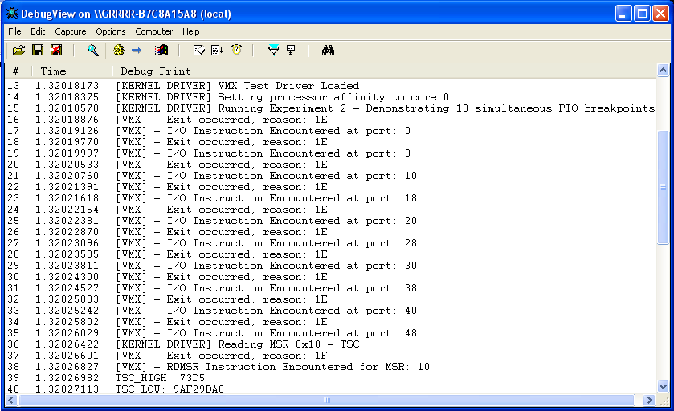
Enhanced Debugging Capabilities
Nearly Unlimited Breakpoints
This experiment demonstrates 10 simultaneous port I/O breakpoints
Port I/O was chosen to compare with the hardware breakpoint limit of four

Slide 17
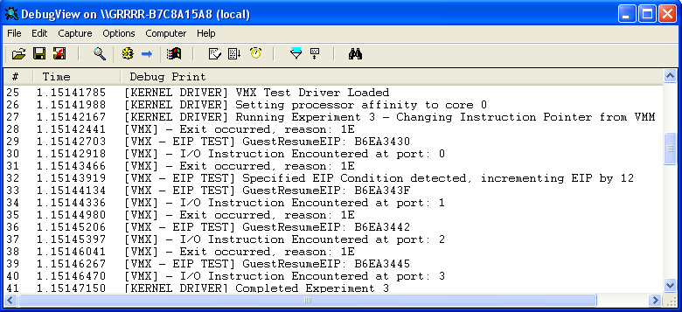
Enhanced Debugging Capabilities
VMM Control over Guest OS
This experiment helps to demonstrate the VMM’s control over the guest OS
The instruction pointer (EIP register) was modified directly, by the VMM

Slide 18
Smart Filtering of Data During Dynamic Analysis
Overview
Virtual Breakpoints can be tailored to trap under specific conditions to filter large amounts of code during dynamic analysis
This decreases debugging time by quickly isolating areas of interest
Previously, the memory or port I/O address must have been identified ahead of time, or else the code must be manually stepped through
Two experiments were performed to demonstrate this concept
Virtual breakpoint on processor mode switch (protected mode vs real mode)
Model Specific Register (MSR) modification
IA32_THERM_INTERRUPT
IA32_PAT

Slide 19
Smart Filtering of Data During Dynamic Analysis
Processor Mode Switch Experiment
This experiment tailors a virtual breakpoint that will trap on a processor mode switch
The VMM traps on access to CR0
The VMM’s software handler monitors bits 0 (paging) and 31 (Protected Mode Enable)

Slide 20
Smart Filtering of Data During Dynamic Analysis
MSR Experiments
This experiment tailors a virtual breakpoint that will trap on access to a specific MSR
The VMM traps on access to any MSR
A specific MSR, or even specific bits of an MSR, can be filtered and configured as a virtual breakpoint within a VMM’s software handler
OS kernel development debugging scenario’s for:
IA32_THERM_INTERRUPT MSR and IA32_PAT MSR

Slide 21
Analysis of Complex Debug Environments
Overview
Virtual Breakpoints can be used to help debug through conditions that would otherwise be difficult to analyze
Simplify the process of debugging through complex conditions
Avoid modifications to guest software and system state that would otherwise be required
Two experiments were performed to demonstrate this concept
Virtual breakpoint to trap on hardware breakpoints
Hardware breakpoint exception
Virtual breakpoint to trap on errors
Divide by zero error from ring-3 application
Breakpoint on triple fault with recovery

Slide 22
Analysis of Complex Debug Environments
Virtual Breakpoint on Hardware Breakpoint
Virtual Breakpoints can be configured to trap on exceptions
Standard hardware breakpoints trigger exception 0x01 to occur
No modifications to system state such as hooking an interrupt to catch an exception
Seamlessly debug a kernel debugger

Slide 23
Analysis of Complex Debug Environments
Virtual Breakpoint on Errors
This experiment demonstrates setting a virtual breakpoint to trap on errors
A divide by zero error was generated from a ring-3 application
This is accomplished by configuring a VM-Exit to occur on exception 0

Slide 24
Results vs. Motivation
Increased granularity of potential breakpoints can greatly decrease the time necessary to analyze executables where source code and symbols are not available
Increased number of hardware breakpoints simplifies analysis of complex code by allowing to simultaneously monitor many resources
Error states can be analyzed without crashing the debugger
Debugging capabilities can extend outside of a specific environment
These debugging capabilities will be free of cost
Analysis is transparent to the target operating systems (except timing)

Slide 25
Future Work
Additional Virtual Breakpoints
A vast number of different virtual breakpoints can be configured
I will be implementing the following virtual breakpoints in the near future:
Triple fault
Specific exit condition – Potential to recover from a triple fault without rebooting guest OS
Interrupt hooking
SIDT/LIDT – required to locate the base address of the IDT in memory
Debug register access
Specific exit condition – Straight forward

Slide 26
Future Work
GUI Interface for Debugger
C# GUI application for the debugger front-end
Ring 0 device driver to receive IOCTL’s from the C# application
Pre-determined port I/O range selected to establish communication protocol with the VMM
Potential for same method from ring 3 – VMM may catch I/O before exception?
The VMM will be configured to cause VM-Exits on communication ports, retrieving data from the ring-0 device driver
Data will be passed back using the same I/O ports
A shared memory address can also be established for large requests

Slide 27
Future Work
Software Debugger for Multiple Environments
Software based debugging environment for multiple operating systems
The Malware Analysis Virtual Machine Monitor (MAVMM) publication explained that it bootstrapped a VMM using GRUB
Our debugger can be loaded the same way
The debugger GUI would need to be altered to load from multiple environments
Text mode interface similar to SoftICE

Slide 28
Full List of VMX Exit Conditions
0 – Exception or NMI (Non Makeable Interrupt)
1 – External Interrupt
2 – Triple Fault
3 – INIT Signal
4– Startup IPI
5 – I/O SMI
6 – Other SMI
7 – Interrupt Window
8 – NMI Window
9 – Task Switch
10 – CPUID Command
11 – GETSEC Command
12 – HLT Command
13 – INVD Command
14 – INVLPG Command
15 – RDPMC Command
16 – RDTSC Command
17 – RSM Command
18 – VMCALL Command
18 – VMCALL Command
19 – VMCLEAR Command
20 – VMLAUNCH Command
21 – VMPTRLD Command
22 – VMPTRST Command
23 – VMREAD Command
24 – VMRESUME Command
25 – VMWRITE Command
26 – VMXOFF Command
27 – VMXON Command
28 – Control Register Access
29 – MOV DR
30 – I/O Instruction
31 – RDMSR
32 – WRMSR
33 – VM-Entry failure
due to invalid guest state
34 – VM-Entry failure d
due to MSR loading
36 – MWAIT Command
37 – Monitor Trap Flag
39 – MONITOR Command
40 – PAUSE command
41 – VM-Entry Failure
due to machine check
43 – TPR Below Threshold
44 – APIC Access
46 – Access to GDTR or IDTR
47 – Access to LDTR or TR
48 – EPT Violation
49 – EPT Misconfiguration
50 – INVEPT
51 – RDTSCP
52 – VMX-preemption timer expired
53 – INVVPID
54 – WBINVD Command
55 – XSETBV Command

